Slide 1
INTADM21AJ014 - Crime Management System
Arpita Bhargava
Vivek Sheel Shakya
Suvidya Sharma
Vignesh K.
Avanija S.
13th May

Slide 2
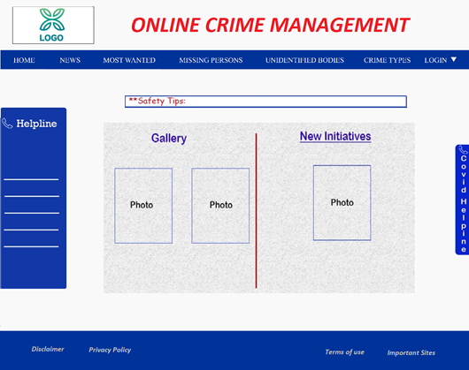
Homepage
2

Slide 3
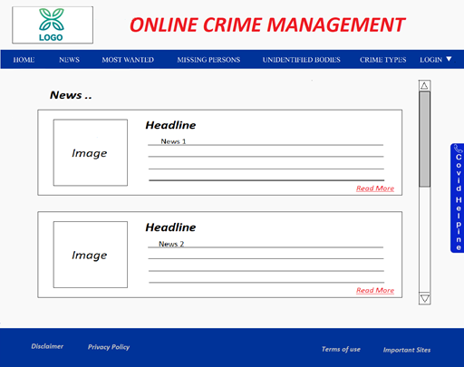
News
2

Slide 4
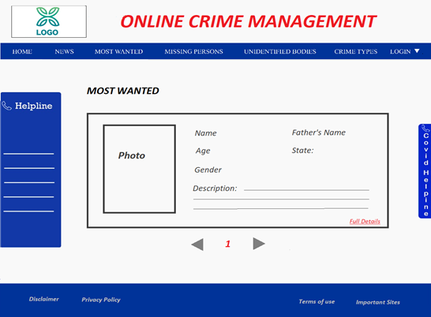
Most Wanted
2

Slide 5
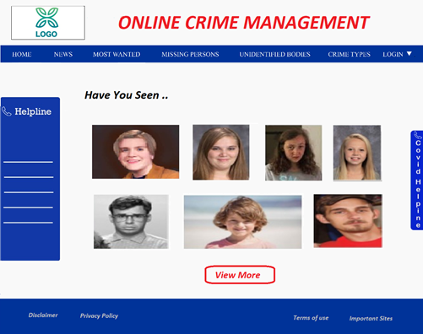
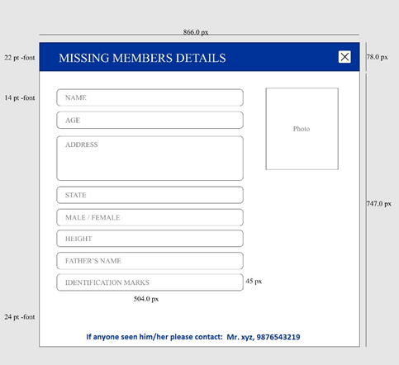
Missing Persons
2

Slide 6
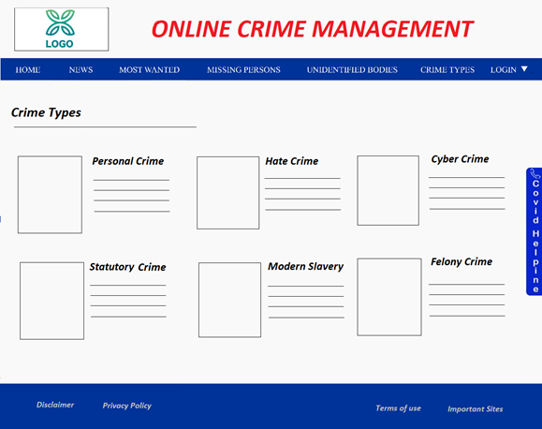
Crime Types
2

Slide 7
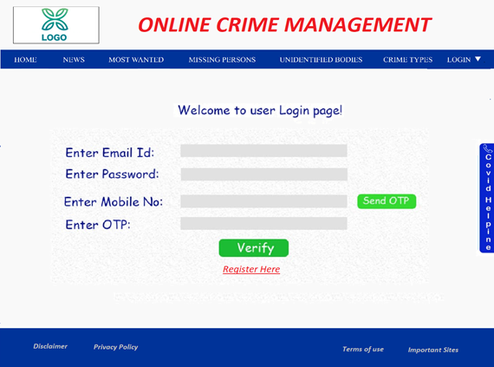
User Login
2

Slide 8
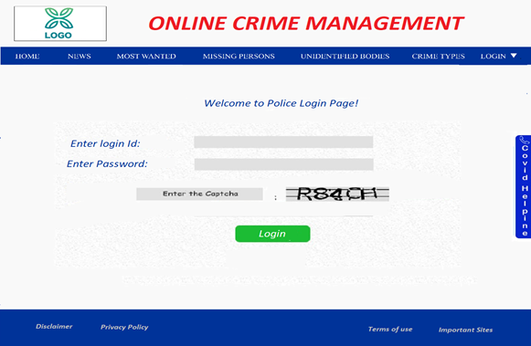
Police Login
2

Slide 9
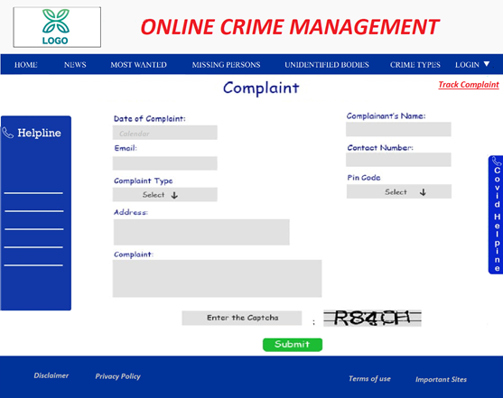
Complaint
2

Slide 10
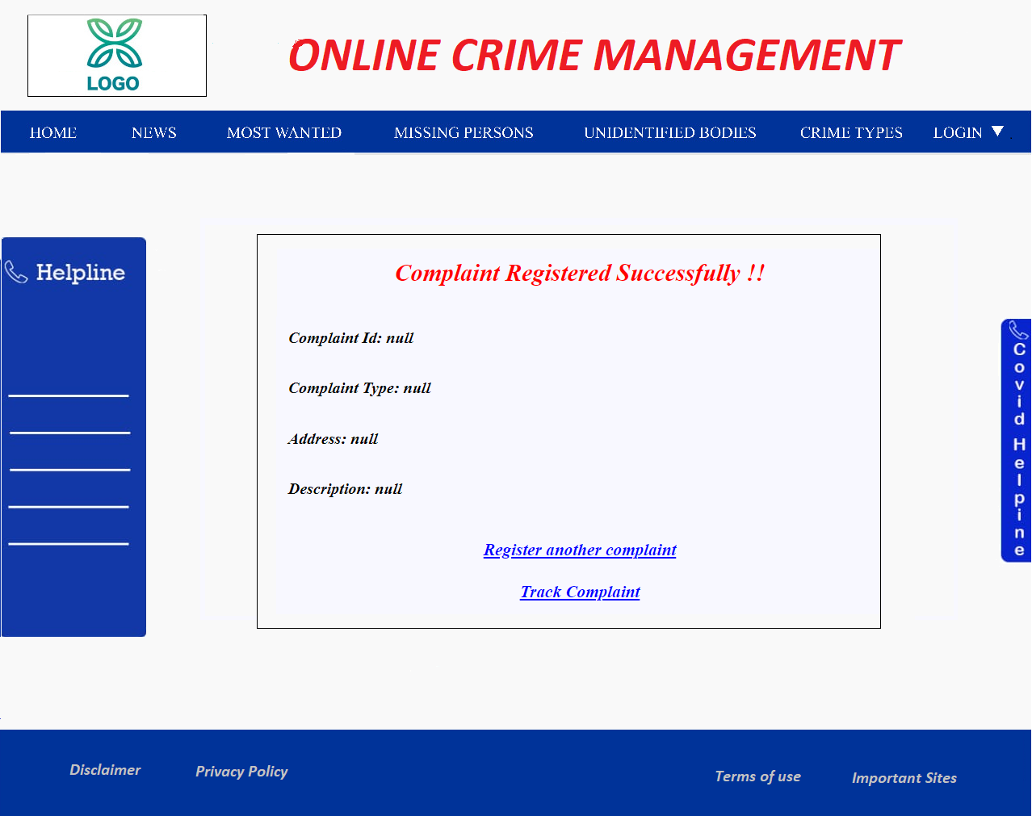
Complaint Confirmation
2

Slide 11
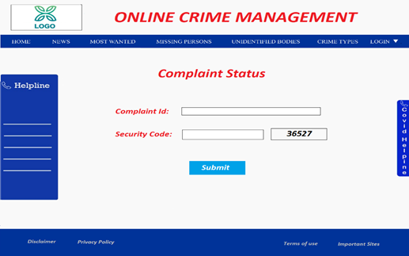
Track Complaint
2

Slide 12
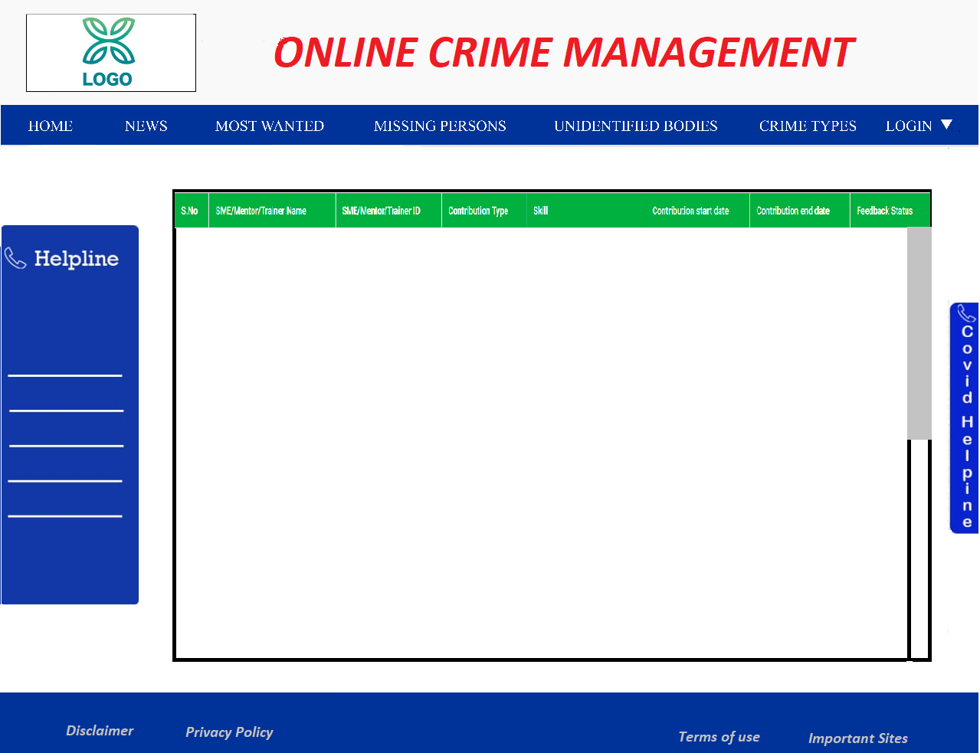
Police Overview Page
2

Slide 13
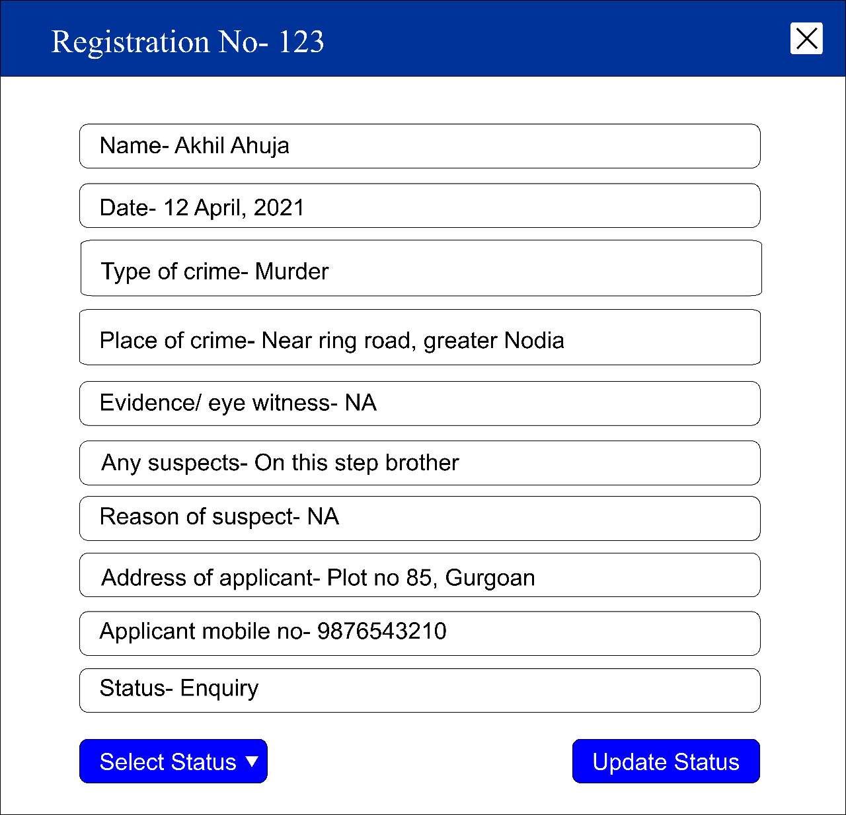
Update Status Page
2

Slide 14
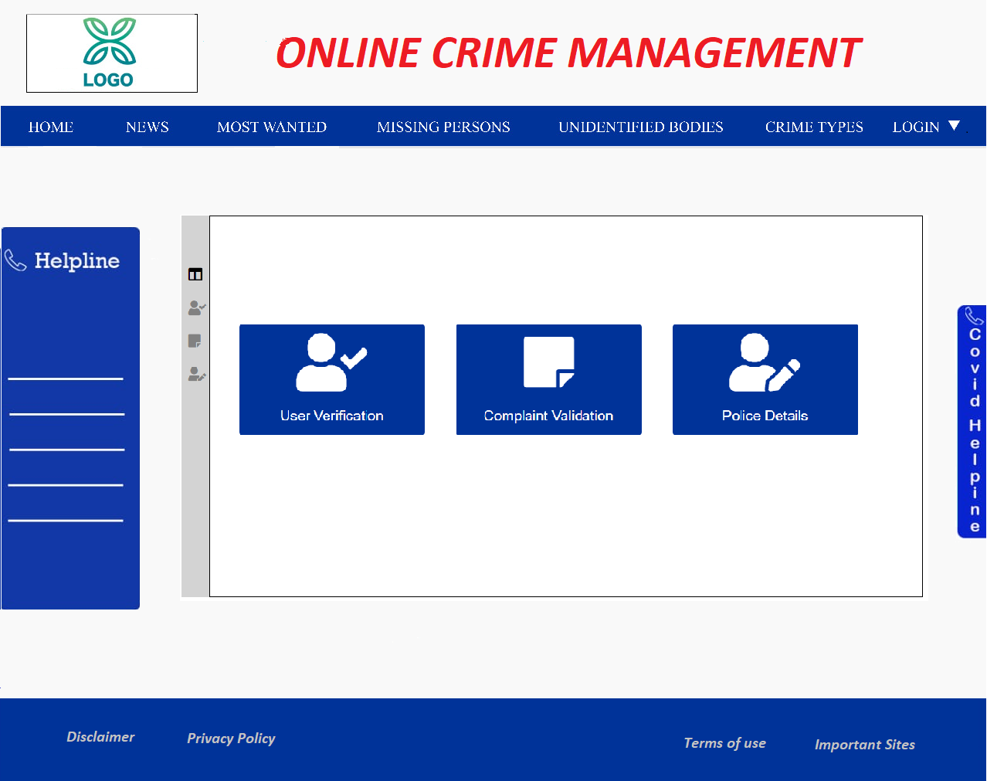
Admin Dashboard Page
2

Slide 15
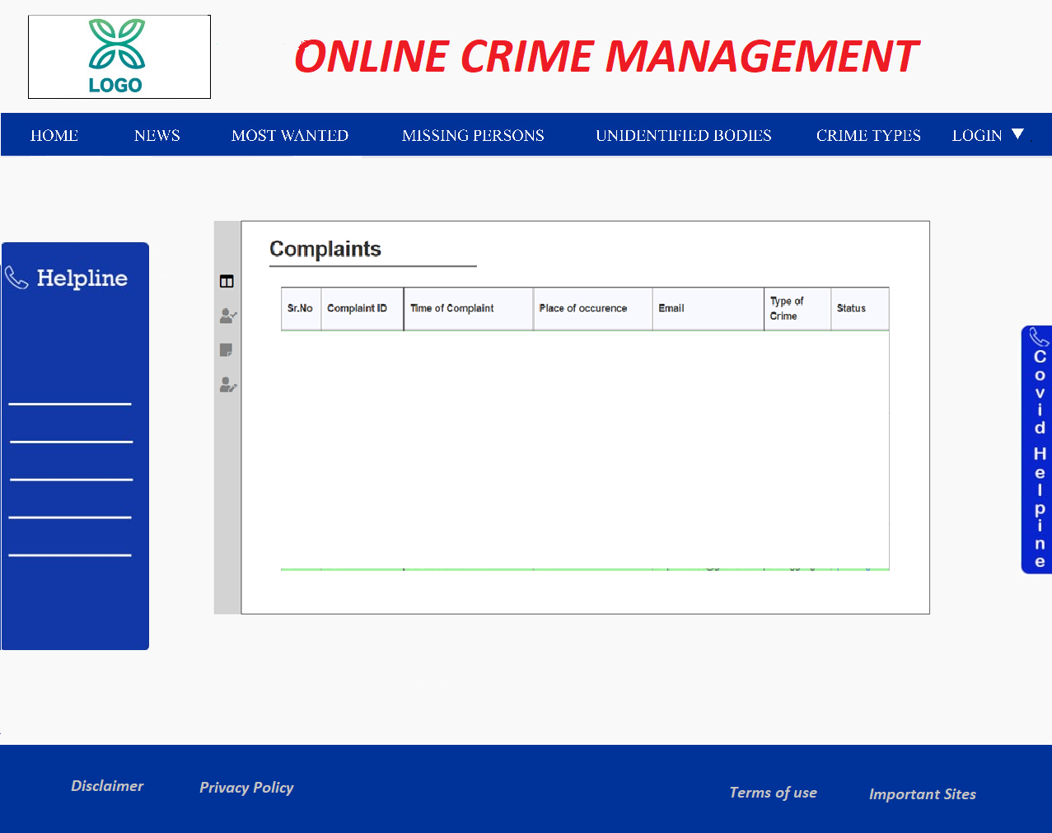
Complaint Validation Page
2

Slide 16
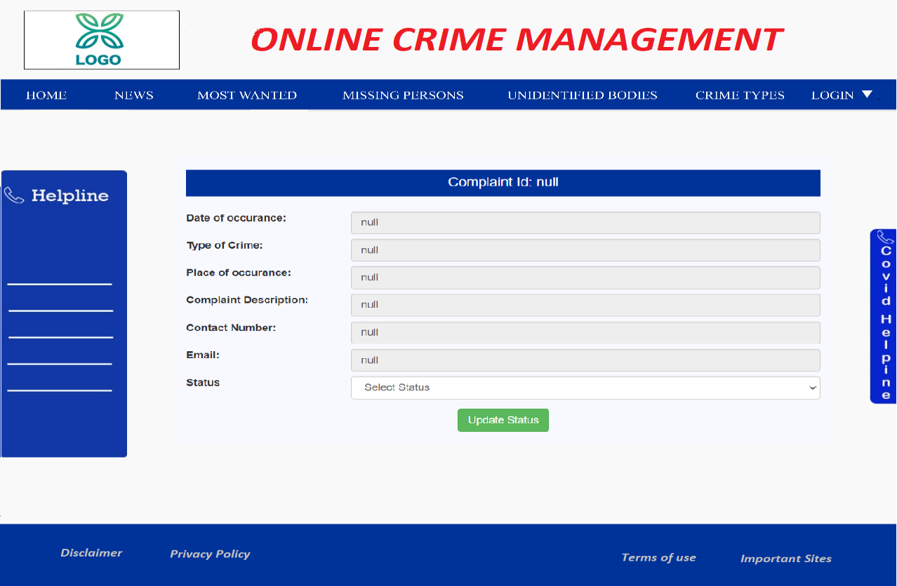
Complaint Validation Status Update Page
2

Slide 17
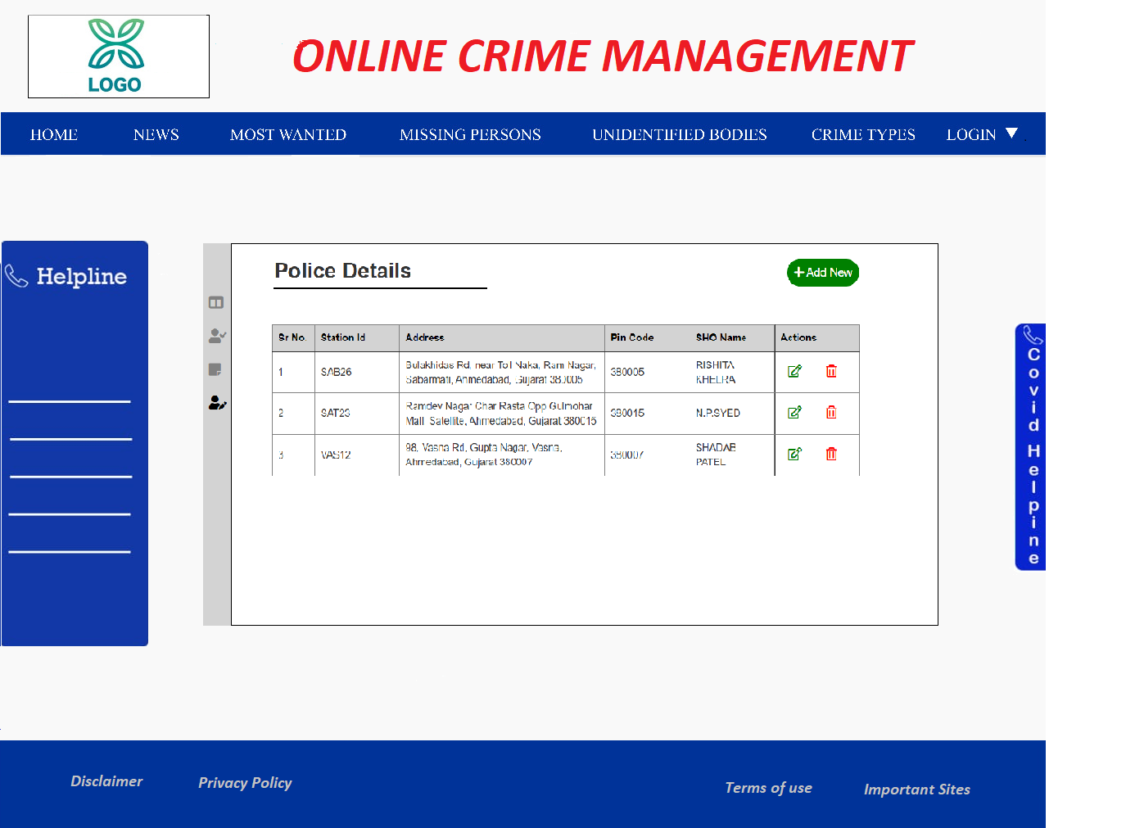
Police Information Update Page
2

Slide 18
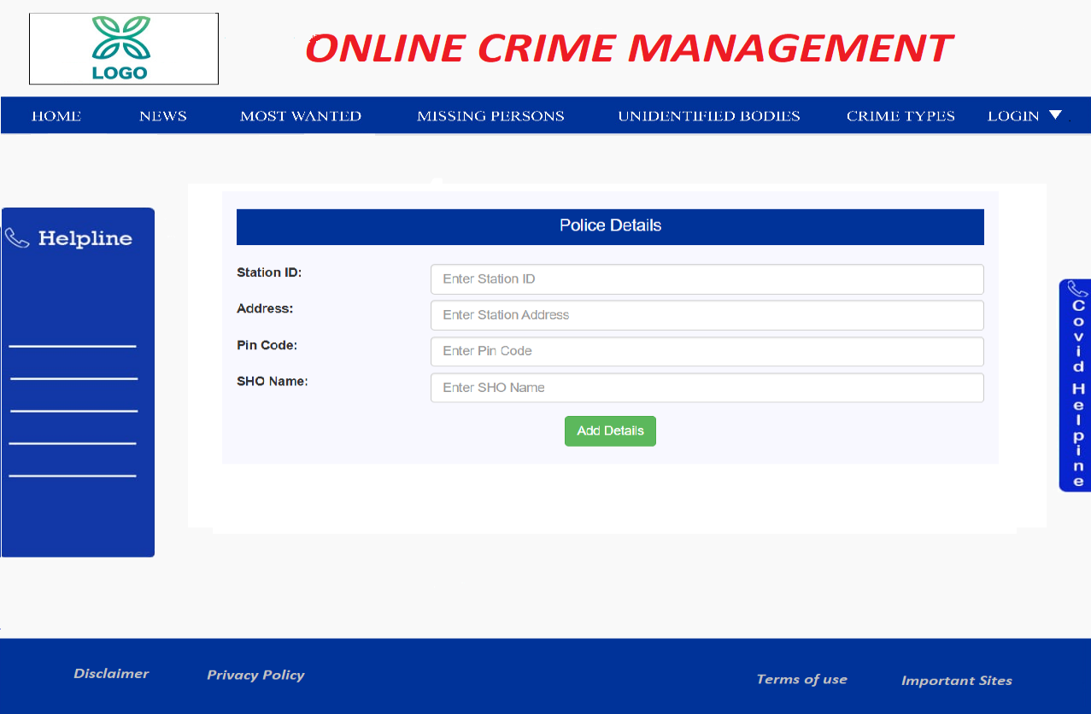
Add/Update Police Page
2

Slide 19
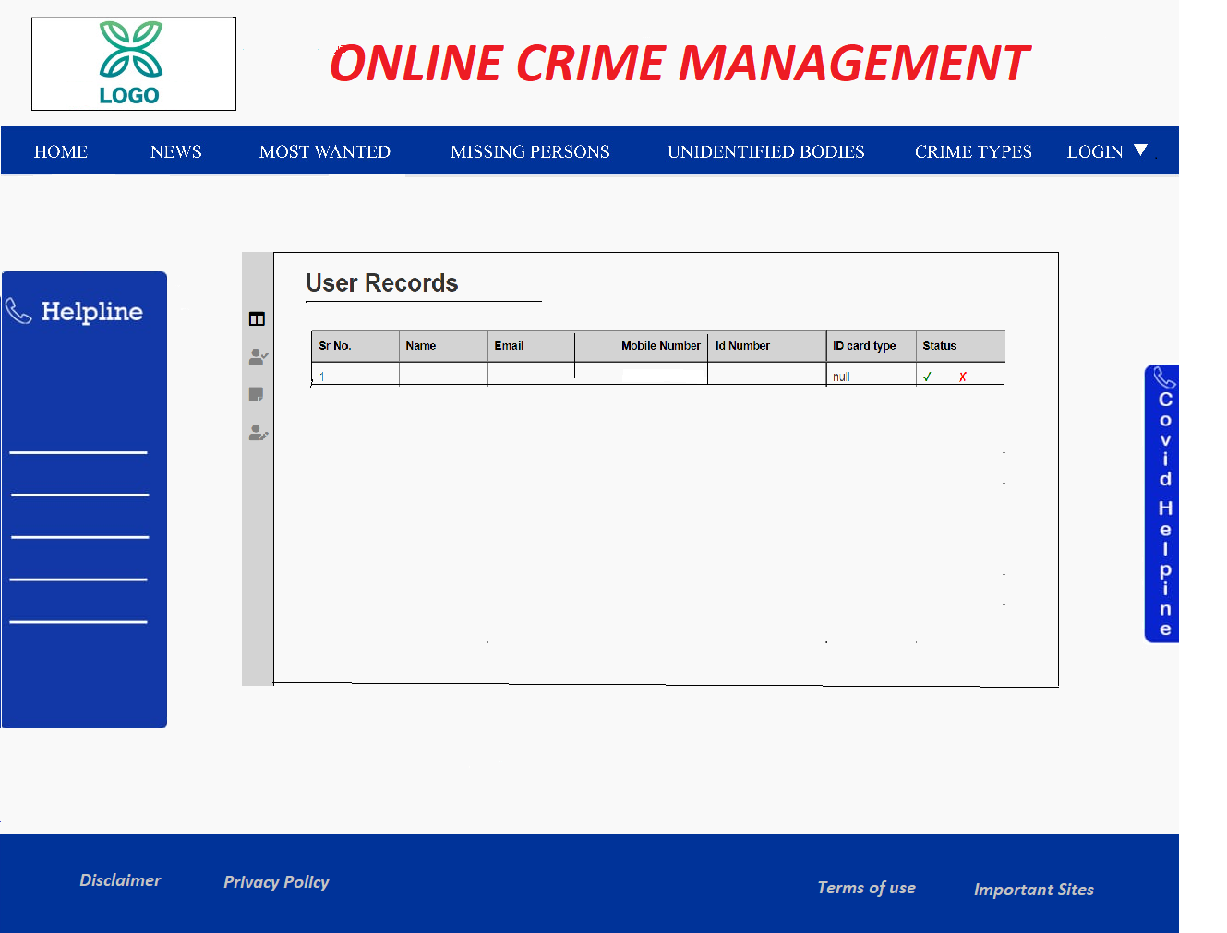
User Validation Page
2

Slide 20
Thank You!
Vivek Sheel Shakya
VivekSheel.Shakya@cognizant.com

